Slide 1
RUNGTA COLLEGE OF DENTAL SCIENCES & RESEARCH
HAEMORRHAGE AND SHOCK
DEPARTMENT OF GENERAL MEDICINE

Slide 2
Specific learning Objectives
At the end of this presentation the learner is expected to know ;
Core areas* | Domain ** | Category #
HAEMORRHAGE AND ITS TREATMENT | COGNITIVE | DESIRED TO KNOW
SYNCOPE | COGNITIVE | DESIRED TO KNOW
SHOCK | COGNITIVE | DESIRED TO KNOW
COLLAPSE | COGNITIVE | DESIRED TO KNOW
HEAD INJURY | COGNITIVE | DESIRED TO KNOW

Slide 3
Table of Content
HAEMORRHAGE AND ITS TREATMENT
SYNCOPE
SHOCK
COLLAPSE
HEAD INJURY

Slide 4
HAEMORRHAGE

Slide 5
Definition-Escape of blood from the blood vessel. This may result in reduction in circulating blood volume, if it is large and untreated may to hypovolumic shock.
CLASSIFICATION OF HAEMORRHAGE-
Depending upon the type of vessel-
A)Arterial bleeding
B) Venous bleeding
C)Capillary bleeding

Slide 6
Classification of hemorrhage contd.-
2. Depending upon the site of bleeding-
A) Internal bleeding-Rupture of liver ,aneurism burst etc.
B) External bleeding-Thru. Cut in skin or through existing openings of body like-nose, ear anus, vagina.
3.Depending upon the timing in surgically operated patient-
A)Primary hemorrhage
B)Reactionary hemorrhage
C)Secondary hemorrhage
4.Depending upon the onset of haemorrhage.
A)Acute
B) Chronic in nature.

Slide 9
Causes of haemorrhage-
1. Trouma,road accident are major cause.
2. Medical diseases-Haemophilia, Chrismus disease, DIC,
liver failure etc.
3. Diseases of body organ-Cancer,
4. During major surgery
Pathophysiology of haemorrhagic shock-
The evolution of haemorrhage and resulting shock
can be described in 4 stages.
Stage 1.. when the blood loss is less than 15%(less than 750ml)Apart from a mild tachycardia and thirst,there is no other sign and symptom.The blood pressure,urine output and mental state are normal in this stage.This is possible due to the peripheral venoconstriction.

Slide 10
Stage 2.-Blood loss is between 15 to 30% (800-1500ml of blood.)
Here beside veno-constriction, release of adrenaline and nor-adrenaline occures which causes powerful vaso-constriction of arteries and veins both. Also increased secretion of ADH causes retention of water and salt by the kidneys.
Clinically-
Heart rate-100-120/mt
Diastolic pressure-raised
Urine output reduced
Limbs may look pale
Patient is confused and thirsty

Slide 11
Stage 3
Blood loss is 1500-2000ml.(30-40%)
All the signs and symptoms of stage-2,get worst.
Blood pressure falls.
Heart rate-120+ and pulse is thready.
Respiration rate is 20+
Urine output further falls(10-20ml/hr)
Patient is drowsy or confused.

Slide 12
Stage 4
Blood loss of more than 2000ml(more than40%)
Pulse is thready and 120+
Limbs are cold and ashen.
Blood pressure is very low or unrecordable.
If still untreated may lead to renal failure,liver failure,GIT-mucosal ulceration and ultimately multiorgan failure leading to death.

Slide 13
MEASUREMENT OF BLOOD LOSS
Clot size of a clinched fist is 500ml.
Blood loss in a closed tibial fracture is 500-1500ml,in a fracture femur is 500-2000ml.
Weighing the swab before and after the surgery.
Hb% and PCV estimation.
Blood volume estimation.
Measurement of CVP and PCWP
By certain investigation (x-ray chest for haemothorax, CT in head injury etc.

Slide 14
MANAGEMENT
A—General management B—Specific management
GENERAL MANAGEMENT
1.Ensure AIRWAY.
2.Ensure BREATHING
3.Ensure circulation
4.Hospitalisation
5.Assessment of injury and history.
6.Oxygen by mask
7.I.V.line and crystalloid solu. Infusion
8.Blood grouping and cross matching.
9.Antibiotic ,Tetanus toxoid ,AGGS etc.as per assessment.

Slide 15
SPECIFIC MEASURES
Pressure and packing
Position and rest-Elevation of leg in varicose vein bleeding, Anti- trendelenberg position in bleeding after thyroid surgery.
Tourniquets- 2 types
1.Pneumatic cuffs. 2.Rubber bandage
Indications—When bloodless field is desired during surgery.(repair of nerves,tendon,reduction of fractures etc.
Contraindication—Pt. with peripheral vascular diseases.
complication—Ischaemia and gangrene,tourniquet nerve palsy.
Surgical methods to control the bleeding-
1) Application of artery forceps.
2) Application of ligatures
3) Cauterization(diathermy)
4) Application of bone wax
5) Silver clips used in cerebral bleeding.
6) Complete resection (hysterectomy,spleenectomy) 0r repair of
damaged organ.

Slide 17
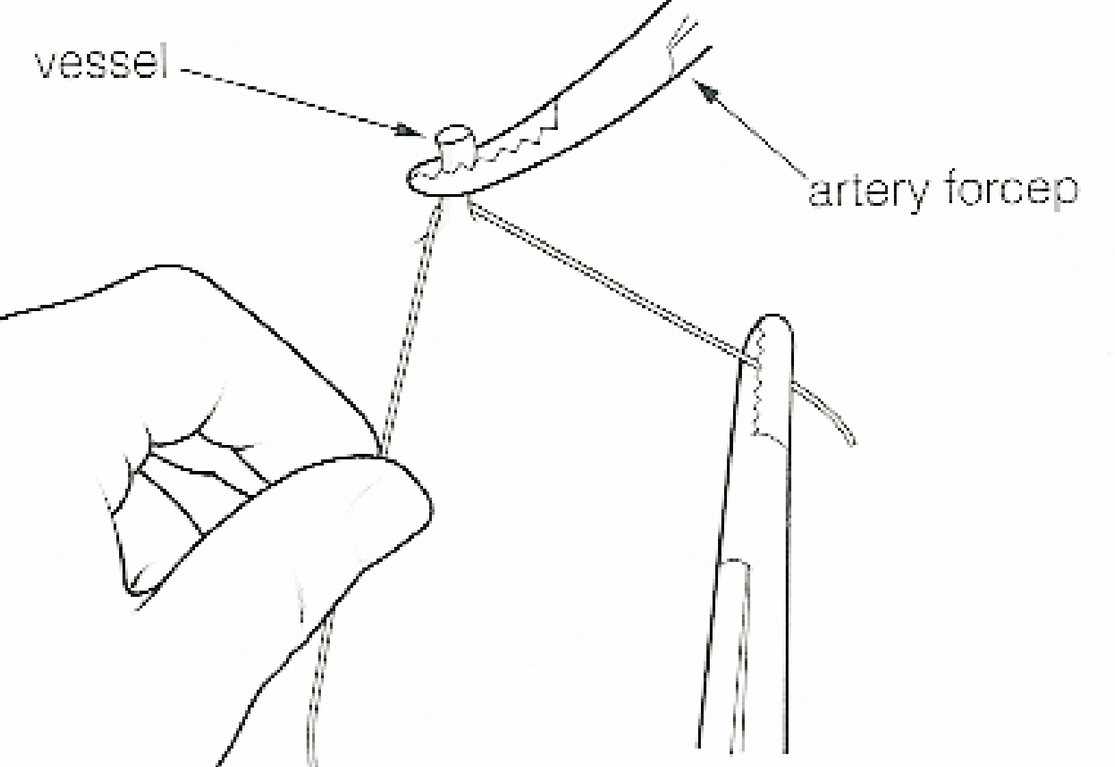

Slide 18
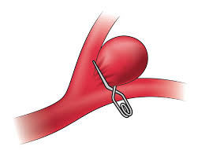
Cerebral aneurysm-clipping using titanium

Slide 19
SHOCK

Slide 20
SHOCK
Definition—Shock is an state of medical emergency which is characterised by HYPOPERFUSION and severe DYSFUNCTION of vital organs.It is due to the circulatory failure which result in insufficient supply of oxygen and nutrients to cells as well as insufficient removal of metobolic by-product from the cells. All these result in error in cell metabolism and the organ does not function properly.

Slide 21
CLASSIFICATION OF SHOCK
1.HYPO-VOLUMIC SHOCK
2.CARDIOGENIC SHOCK
3.Distributive shock
4.Obstructive shock

Slide 23
The dense networks of capillaries present a large surface area, which allowsmaterials to be exchanged between body cells and the blood rapidly. Oxygen and dissolved foods diffuse into body cells from the blood, and carbon dioxide and other waste products diffuse out of body cells into the blood.

Slide 24
Pathophysiology of Shock
Hypoxia
Anerobic metabolism
Lactic acidosis
Cell wall damage
Sodium and Calcium enter the cell and potassium leaks out of the cell
Intraculler lysosomes break down releasing powerful enzymes, which destruct own cell
Sick cell syndrome
SIRS
DIC
MODS
Death

Slide 25
HYPO-VOLUMIC SHOCK
When there is reduction in blood volume circulating in the body, this result in hypovolumic shock.
The circulating blood volume may get reduced in following ways-
1.loss of whole blood as in haemorrhage due to trauma.
2.Loss of plasma as seen in burn cases.
3.Loss of fluid ie. dehydration in gastro-enteritis etc.
Pathophysiology-Low bl.volume result in insufficient filling of heart chambers that is, decrease in preload that causes reduced cardiac output and hence the shock develops.

Slide 27
CLINICAL FEATURES-
This depends on the degree of hypovolumia. The usuals signs are
1. Tachycardia
2. Feeble pulse
3. Low blood pressure
4 Tachypnoea
5. Peripheries are cold and patient may be in confused state.

Slide 28
MANAGEMENT
1.INVESTIGATION-
a) Routine blood & urine exam
b) Blood sugar exam.
c) Blood grouping & cross-matching
d) Organ specific –LFT,RFT,SGOT,SGPT etc.
2.TREATMENT-
The primary goal is to maintain and bring back the normal blood volume. So, either by infusion of whole blood, or by crystalloid solution/colloidal solution blood volume is restored.(guide lines-crystalloid 2-3 times the blood lost, colloids 1-1.5 times of bl. loss and blood transfusion must if Hb% is below 8-10gm%)

Slide 29
TREATMENT-
A.General treatment-
*Hospitalisation
*Oxygen inhalation
*I.V. line to maintain for infusion.
Infusion of blood ,colloidal or crystalloid solu.
*Blood grouping &cross matching
*Antibiotics,analgesics,sedatives.
* Antitetanus and AGGS if assessed.
B.Treatment of the cause-
*Care of injury.
*Care of burn parts
*Diarrhoea and vomittings to be controlled.

Slide 30
CARDIOGENIC SHOCK

Slide 32
CARDIOGENIC SHOCK
Definition-It is a medical condition in which heart is unable to pump the blood as per the need of the body. This is due to the intrinsic problem in the heart .A massive myocardial infarction may damage the heart muscles and there is not enough healthy muscles which can pump the blood effectively .Any damage to cardiac volve may also effect the cardiac output.

Slide 33
Following features may be observed-
1. Decrease in contractility of heart.
2. Decrease in cardiac output
3. Left ventricular pressure is high.
4. Clinically tachycardia, low blood pressure and
low urine output.
5. In lungs-bilateral crepitations due to pulmonary
oedema.
6. The peripheries are cold and patient may be in
confused state.

Slide 34
TREATMENT-
Oxygen by mask or by endotracheal intubation
Use of Inotropes to improve the contractility of cardiac muscles
Use of vasodilators to improve the coronary circulation in heart and in peripheries for better tissue perfusion. Close watch is required while using vasodilators.
Intra-aortic balloon pump or other intraventricular devices may be used to assist ventricles.
If above all are unresponsive, then revascularization or valve replacement may be considered on emergency basis.
*****

Slide 35
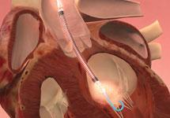

Slide 36
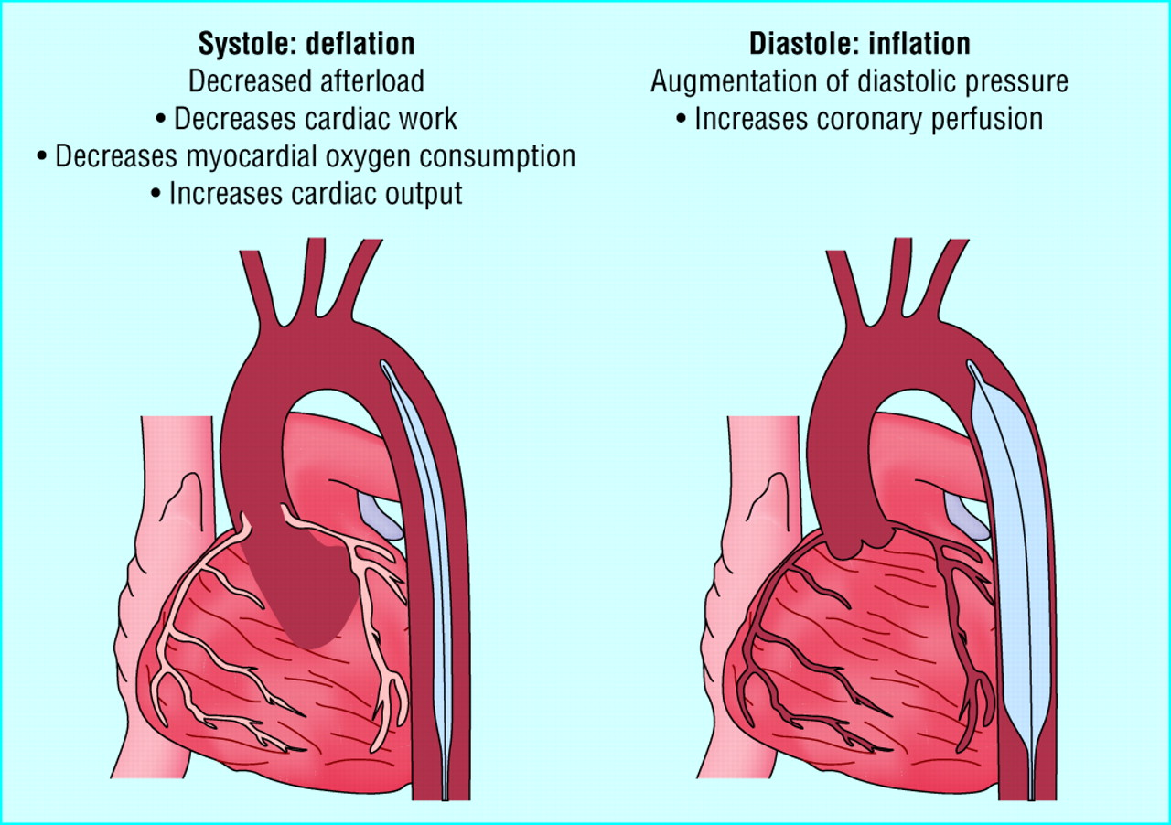

Slide 37
DISTRIBUTIVE SHOCK

Slide 38
DISTRIBUTIVE SHOCK
DEFINITION-
Distributive shock is - due to excessive peripheral vasodilatation which causes impaired blood flow to the tissues and organs.
It is caused due to loss of vasomotor tone resulting in peripheral dilatation of arteriols and venular and characterised by increased cardiac output (after resuscitation) and decreased superior vena cava return.

Slide 39
Distributive shock may occur in following condition-
1.Septic shock
2.Anaphylactic shock
3.Neurogenic shock
4.Acute adrenal insufficiency.

Slide 40
SEPTIC SHOCK
Definition- It is a state of shock due to severe sepsis and persistent hypotention inspite of fluid resuscitation.
Sepsis is the severe form of body response to infection.The infection may be caused by gram+ve, gram-ve bacteria, viruses, fungi 0r even protozoal infection.
Patholog- The effect of local inflammation and the complex chemical released by the bacteria( endotoxin by gram-ve and exotoxin by gram+ve) activates the CD14 of neutrophils,monocytes and tissue macrophages. These all result in cascade of pro and anti-inflammatory cytokines and other mediators.The effect of these mediators results in vaso-dialatation,cellular chemotaxis,endothelial injury and activation of coagulation process.All these finally leads to development of septic shock.

Slide 41
CLINICAL FEATURES-
These can be described in two phases.
1)Reversible stage : ( also warm stage or hyperdynamic stage)Here pyrogenic response is continued. Body is warm. Rapid pulse. Respiration is hurried. Blood pressure may normal or on low side.
This stage is reversible if proper and timely treatment is done, which will include antibiotics administration, identifying the source of infection and taking all remedial measures to eliminate this source along with other supportive treatment.
2)Irreversible stage(cold stage or also called Hypodynamic stage) Here body response to infection ceases.Body is cold.Respiration is sluggish .MODS has set.features of renal and liver failure are seen as anuria and joundice. Patient is in coma and cynosed. Death is imminent.

Slide 42
Investigation
All investigations to identify and localise the infection and its source.This may include—
blood culture
X-rays
CT scan & MRI etc.
RFT, LFT, SGPT, SGOT AND
other routine test.

Slide 43
Treatment-
Identification and elimination of source of infection.This may require-drainage of pus ,resection of gangrenous bowel of even amputation of part of a limb 0r whole limb.
Appropriate antibiotic
Intravenous fluid in form of crystalloid solu. / colloid solu. Or whole blood may be infused.
Supportive treatment-
Oxygen by mask/ thr, endotracheal tube
Ventilatory support.
Catheterisation to monitor urine output
Nursing care
Use of vaso-active agents-Noradrenelin ,dopamine, adrenelin have been used to increase systemic pressure and cardiac contraction.
Activated protein ‘C ‘ has shown some good result in checking the release of some inflammatory mediators.

Slide 44
ANAPHYLACTIC SHOCK

Slide 45
ANAPHYLACTIC SHOCK
Anaphylactic shock occur due to exposer to some allergen.The allergen may be pollen,food stuff or a medication.The anaphylactic shock seen in hospital is mostly due to penicillin drug.
In sensitive persons,the allergen react with the IgE of the mast cells and basophil cell which releases the large amount of histamin and SRS-A.(slow releasing substance of anaphylaxis)
These complex mediators causes sudden acute vasodilatation and bronchial and laryngeal spasm.

Slide 46
Clinical features
Early stage –
Tachycardia,
Sweating,
Cold periphery,
Hypotension,
Restlessness,
Air hunger,
Tachypnoea,
Collapsed vein
Late stage –
Cynosis,
Anuria,
joundice and
unconsciousness appears.

Slide 47
TREATMENT-
Early treatment-
Lay down the patient 0n floor and elevate the legs.
Oxygen inhalation(by mask or thr.endotrecheal intubation)
Injection Adrenalin(1-1000) 0.5-1mg IM or 50-100 ug intravenous to maintain blood pressure.
Intravenous fluids-Isotonic saline or Ringer lactate solu.
Early treatment is followed by-
Inj.chlorphenaramine maleate 10-20 mg IV
Inj.Hydrocartisone 100mg intravenous
Regular monitoring of Pulse , Blood pressure & Respiration.
In some cases ,CVP line ,PCWP ,estimation of serum electrolyte and measurement of urine output may be required.

Slide 48
NEUROGENIC SHOCK
Neurogenic shock is a distributive type of shock
resulting in low blood pressure, occasionally
with a slowed heart rate, that is attributed to
the disruption of the autonomic pathways
within the spinal cord. It can occur after
damage to the central nervous system, such as
spinal card injury.

Slide 49
Causes-
High spinal card injury- This injury result in loss of sympathetic innervations to blood vessels causing vasodilatation.
2. Vasovagal syndrome (Neurocardiogenic shock)-
Due to some trigger,vagus nerve is activated,causing reduced heart rate and low cardiac output.The trigger causes primarily reduction in blood flow to cerebrum which in turn activates NTS in medulla of brain.This NTS(nucleus tractus solitarius) send signal to vagus nerve.
Long standing causing venous stasis in legs and so reduced cardiac output and reducd blood flow to brain.
Extream of emotions
Seeing of blood or some medical procedure.
Extreame pain,sudden standing,during micturition etc.

Slide 50
TREATMENT-
Lie down the victim, loosen the clothing, elevate the legs and provide good open airy ambience.
Assure the patient by councelling.
Intravenous fluids therapy (saline etc.)
Inotropes (dopamine, dobutamine) may be required to increase cardiac contraction.
Vagolytics (atropine) to increase heart rate.
*********************************

Slide 51
ACUTE ADRENAL INSUFFICIENCY
When due to injury or some pathology in adrenal glands, its secretion decreases, resulting in deficiency of adrenalin and nor-adrenalin.
Causes-
1. Primary adrenal insufficiency (Addison’ disease)
2. Secondary adrenal insufficiency(pituitary gland injury, compression)

Slide 52
Clinical features-
Headache, profound weakness, fatigue, sluggish and lethorgic movement.
Nausea, vomiting, low blood pressure, dehydration, rapid heart rate, confusion or in coma.
Treatment-
1. Care of A B C.
2. Hydrocatisone 100-300mg intravenously.
3. Treat the precipitating factor.
4. Antibiotics as required.

Slide 53
OBSTRUCTIVE SHOCK

Slide 54
OBSTRUCTIVE SHOCK
It can be due to-
1 Cardiac temponade or 2.Tension pneumothorax.
CARDIAC TEMPONADE-There is impedance to either inflow or outflow of blood into or out of the heart.This is seen when pericardium is filled with blood or fluid which hampers the normal venous filling of the heart as well as outflow.
Clinically the blood pressure is low and central venous pressure is high.Pulsus paradoxus is also seen.
TREATMENT-1.Maintain preload with fluids or blood
2.Relief of obstruction,drain the pericardial cavity as early as possible.

Slide 55
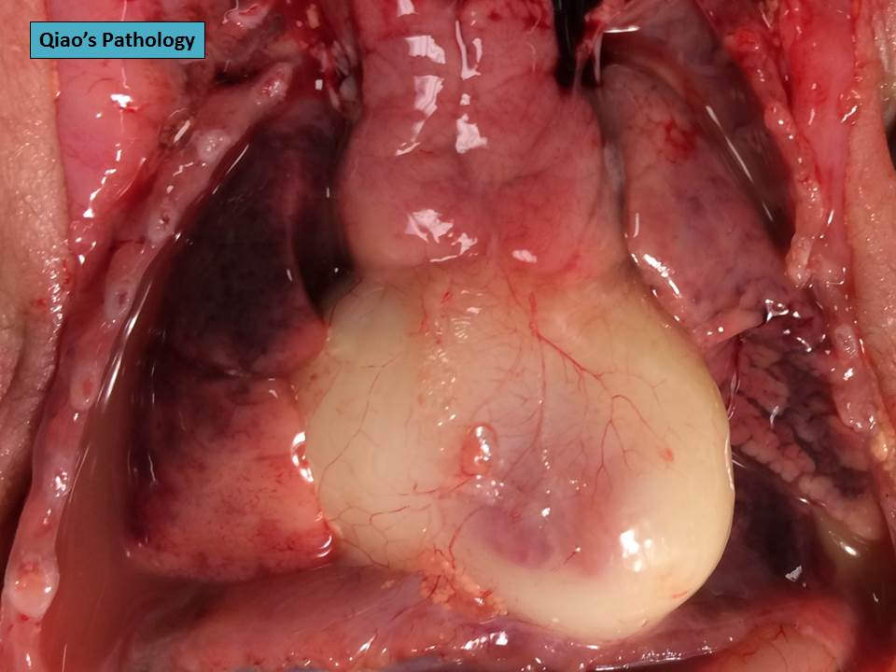

Slide 56
Treatment
* To maintain the preload with fluids or blood as Indicated.
*Relief of obstruction
*Drain the pericardial cavity as early as
possible and release the pressure on heart.
*******

Slide 57
TENSION PNEUMOTHORAX
Causes- 1.Injury to lung due to trauma
2.Ventilator induced barotrauma
3. Rupture of emphysematous bulla
Clinical features-
1. Cynosis
2. Distended neck veins.
3. Tachypnoea, dyspnoea or even resp.arrest.
4. Auscaltation-no air entry on side of pneumothorax and on perccussion-hyper resonance.
5. Tachycardia,hypotension and even cardiac arrest.

Slide 58
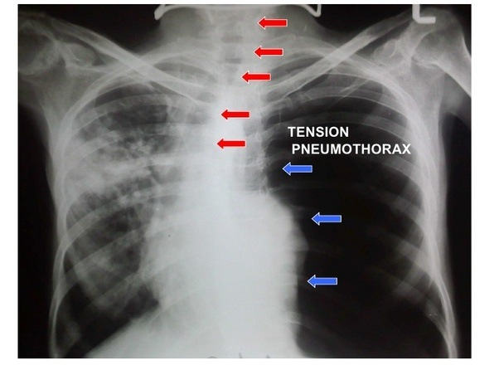

Slide 59
TREATMENT
Specific—A wide bore needle/cannula is to be inserted into the affected side of pleural cavity to drain the air. The needle is inserted in mid-clavicular line in 2nd intercostal space on affected side. This is followed by insertion of tube thoracostomy.
General : Care of ABC
O₂ inhalation through mask / incubation
IV line her fluid infusion and medication
Proper nursing care

Slide 61
HYPERBARIC OXYGEN
Definition-When the oxygen is given to a patient under 1.5 to 2 times greater than the atmospheric pressure in a special chamber for treatment purpose.
Indication-1.Decompression disease(caisson’disease)
2.Carban mono oxide gas poisoning.
3.Gas gangrene
4.Tetanus
5.Air embolism
6.In cancer patient ,to raise radiosensitivity.
Contra-indication- Tension pneumothorax

Slide 63
CENTRAL VENOUS PRESSURE
DEFINITION-
The central venous pressure (CVP) is the pressure measured in the central veins close to the heart. It indicates mean right atrial pressure and is frequently used as an estimate of right ventricular preload. The CVP does not measure blood volume directly, although it is often used to estimate this.

Slide 64
Importance -1. Indicates the volume of blood in the central veins.
2. Indicate the distensibility and contratibility of Rt.heart chamber.
3. Indicates the Intrathoracic pressure and intrapericardial pressure.
4. IN shock,measurement of CVP is essential to plan for proper fluid management.

Slide 65
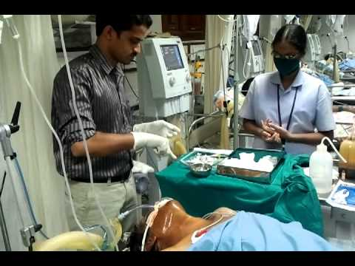
Method- A 20 cm. long venous cathter is passed through Rt.internal juglar vein and placed in SVC/Rt.atrium and blood pressure is recorded thr.saline manometer.

Slide 66
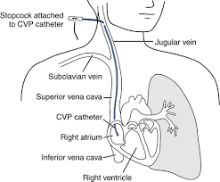

Slide 67
Inferences-
1. The normal value of CVP is 2 to 10 cm of water.
2. If the value is below 2cm,more fluid infusion is required.
3. And if the value is near 10cm or more,than fluid infusion
has to be controlled.
Complications in doing CVP-
a) Haemorrhage
b) Pneumothorax.
c) Hemothorax.
d) Sepsis
e) Injury to nerve and other vessels.
f) Catheter displacement.

Slide 68
PCWP
Pulmonary capillary wedge pressure-this is a better indicator of circulating blood volume and Lt. ventricular function.
Uses
To differentiate Rt. And Lt. ventricular failure,
Pulmonary embolus and
Septic shock
To monitor Cardiac output
Medication-inj.inotropics,vasodialators.

Slide 69
Procedure
- A triple channel Swan ganz catheter is passed thru. IJV then ino the Rt.atrium to Rt.ventrical to pulmonary artery and finally to smaller artery. There balloon is inflatted and pushed further where it wedges in the opening of one of the small artery.The blood pressure recorded at this point is called PCWP.
After that balloon is deflatted and blood pressure is recorded.This blood pressure is called PULMONARY ARTERY PRESSURE(PAP)
Normal value - PCWP is 8 – 10 mm of Hg.(MAP)
PAP is 25/10 mm of Hg.

Slide 70
COMPLICATION
1. ARRTHYTHMIAS
2. PULMONARY ARTERY PUNCTURE
3. PULMONARY INFARCTION
4. HEMOTHORAX AND PNEUMOTHORAX
5. BLEEDING,SEPSIS AND THROMBOSIS.
*********************

Slide 71
BLOOD TRANSFUSION
Indication-
1 . Acute massive blood loss
2. Severe anemia and hypoalbuminemia.,
3. Severe infection
4. Disorders of coagulation.

Slide 72
TYPES OF TRANSFUSION
1. Whole blood
2. Blood component
a)RBC
b)Plasma
c)Fresh Frozen Plasma
d)Platelets and
e)Cryoprecipitate
3. Plasma Substitutes
a) Dextravan
b) Hydroxy-ethyl starch formulations(HES)
Use of whole blood transfusion is considered to be waste of resources.

Slide 73
BLOOD PRODUCTS
Now a days, with one unit of blood, we can provide benefit to many patient . It has been possible due to fractionation of blood into many products.
Packed Red blood cells-obtained by centrifugal of whole blood.
-It is used in severe anemia, in old age and in children.It minimizes the heart load.
2. Plasma--- Obtained by centrifuging whole blood.
-It is used in Burn patient ,hypoproteinaemia and in severe protein loss.
3. Human albumin 4.5% -It is obtained after repeated fractionisation of plasma and can be stored in liquid form for many months at 4.C.
4. FFP (fresh frozen plasma)-It is obtained when fresh plasma is rapidly frozen and stored at -40.C.
Used in severe liver diseases and coagulation disorder.

Slide 74
5. Cryoprecipitate- It is obtained when fresh frozen plasma is allowed to thaw at 4.C. After some time,a precipitate is seen on the top. This is cryoprecipitate.
It is rich in factor viii and fibrinogen
6. Fibrinogen-It is obtained by org. liquid fractionation of plasma. It is stored in powder form.
IT is very useful In DIC and in afibrinogenemia
7. Platlet rich plasma-Obtained by centrifuging freshly donated blood at 150-180 gy. for 15-20 minutes.
8. Platelet concentrate-It is obtained by centrifuging the PRP at 1500-1800gy/mt.
It is used in thrombocytopaenia(as seen in Dengue fever)
****************

Slide 75
PLASMA EXPONDERS (BLOOD SUBSTITUTES)
1.Albumin 4.5%
It is rich protein and carries no risk of hepatitis. Available in 4.5% & 20% solution. It is used in Burn patient, acute hypoalbuminemia and in Nephrotic syndrome.
2.Gelatins-
It is a good plasma expander, effect last for few hours. But incidence of reaction are more common with urea linked gelatin(haemaccel) and less with gelofusin
3.Dextrans-
Low molecular weight dextran40 is commonly used.
It reduces the viscosity and red cells sludging.
May affect renal function and coagulation.
4.Hydroxy-ethyl starch-
Derived from starch.Plasma expansion last more than 24 hrs.
Incidence of reaction are very less.Large dose may interfere with coagulation. Maximum dose is 15ml/kg in 24hrs.
***********************

Slide 76
BLOOD COLLECTION AND STORAGE
Blood is collected in a sac containing 75 ml of CPD (Citrate+Phosphate+Dextrose) solution.
Other solutions used are- CPDA, SAGM (sal.Aden.Glu.Mani.) & ACD.
Blood is stored in special refrigerators at 4.C.
CPD blood can be used upto 3weeks time.
In stored blood-
* RBC last for 3weeks.
*WBC are destroyed rapidly.
*Platelets also get reduced in 24hrs. And so is clotting factor, it falls quickly.Now,with newer technics,it can be stored for 5 days.
Donor criteria—Should be fit & healthy,free from serious diseases like HIV,Hepatitis,Syphilis etc.Weight should be more than 45kg and Hb% more than 12.5gm.

Slide 77
Following changes occur in stored blood-
1.Reduced blood pH (6.7-7.0)
2.Increased potesium in blood.
3.Reduced viability of platelets and leucocytes.
4.Reduced coagulation factors

Slide 78
COMPLICATIONS OF BLOOD TRANSFUSION
1. Immune related complications
a)Haemolytic reaction-
* Major(ABO) incompatibility reaction-this is due to mismatch blood transfusion.It happen mostly due to technical errors like mixing the samples, wrong labelling and dispatch This causes intravascular haemolysis.
Cliniacal features- Haematuria,pain in the loins, fever with chills and rigors and oliguria due to acute renal tubular necrosis.
Treatment- Stop the blood and recheck.
Start IV fluid,monitor urine output & Hb.
Diuresis with frusemide 20-40mg IV or 20% manitol infusion to flush the kidney.
*Minor incompitability reaction-These occurs due to extravascular haemolysis.It occurs due to antibodies to minor antigens.Usually mild in nature and may occur during 2-21 days.
Patient has malaise,fever and may have joundice.

Slide 79
b)Non haemolytic reactions-
1. Febrile reaction-due to WBC & platelets.
2. Allergic reaction-due to plasma product.
3. Transfusion related acute lung injury-it
is a rare complication similar to ARDS.
4. Congestive cardiac failure(CCF)- If whole blood is transfused rapidly in patient with chronic anaemia.slow transfusion or packed cell transfusion will be choice in such patient. Injection furosemide-20mg iv may be required.

Slide 80
2. Infectious complication
Serum hepatitis,AIDS,Malaria,Syphilis are dangerous infectious diseases which can be transmitted during blood transfusion.
Hence,it mandatory to screen the blood for these diseases before transfusion.
3. DISSEMINATED INTRAVASCULAR COAGULATION (DIC)-
In massive blood transfusion wherein all factors of coagulation are used up , resulting in bleeding disorder.It produces severe afibrogenemia.
It is treated by cryoprecipitate( rich infibronogen)
************************

Slide 81
BLEEDING DISORDERS
Haemophilia- X-linked genetic disorder of coagulation.
TYPE- Haemophilia ‘A’
& Haemophilia ‘B’
---------------------------------------------------------------------------------------------------------------
Haemophilia-A
Haemophilia A (or hemophilia A) is a genetic deficiency in clotting factor VIII, which causes increased bleeding and usually affects males.
1:5000 incidence
the level of factor viii, may be less than 1% c
Clinical features- Excessive bleeding.
Unusual bleeding
Unexpected bleeding
Bleeding in joints and muscles is seen.
Intra muscular injection to be avoided.

Slide 82
Treatmnt-
-Give IV- factor viii concentration by
infusion twice daily.
-Any operative procedure should be
done after attaining 100% level.
-Synthetic vasopressin raises factor- 8
level.
****

Slide 83
Haemophilia B-
Incidence 1:30000. It is due to deficiency of
factor ix.(Christmas Factor)
The clinical features-
are similar to haemophilia A.
Treatment - infusion of factor ix concentrates.
*****

Slide 84
Van Willebrand’ disease
Von Willebrand disease (VWD) is a genetic disorder caused
by missing or defective von Willebrand factor (VWF), a clotting
protein. VWF binds factor VIII, a key clotting protein, and platelets
in blood vessel walls, which help form a platelet plug during the
clotting process.
C/features- Epistaxis,menorrhagia and bleeding
following trauma.
T/t- Similar to mild haemophilia.
-Synthetic vasopressin or IV infusion of factor
viii.C
-Concentration of vWillebrand’s feactor BY IV.
******

Slide 85
REFERENCES
SRBS BOOK OF GENERAL SURGERY
A MANUAL ON CLINICAL SURGERY - S DAS
MANIPAL MANUAL OF SURGERY - K RAJGOPAL SHENOY
BAILEY AND LOVES SHORT PRACTICE OF SURGERY

